Slide 1
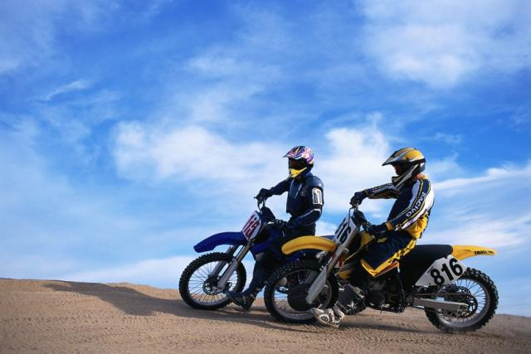
Share-My-Toys, Inc.
3870 West Bear Lake Road
Montpelier, ID 83220
208-555-3870
Share-My-Toys, Inc.

Slide 2
You want to enjoy the great outdoors, but you can’t afford a …
Ski boat
House boat
Wave runner
Canoe
Kayak
RV
ATV
Camping gear
Snowmobile
Other fun toys

Slide 3
How would you like to have all those toys … and more?
It doesn’t seem possible, does it?

Slide 4
They can all be yours … for a lot less than you think …
with
Share
-My-
Toys

Slide 5
What is Share-My-Toys?
It’s a timeshare coop for recreational equipment.
It’s an easy way to enjoy the great outdoors with all the equipment you need.
It’s shared ownership of boats, waverunners, snowmobiles, ATVs, and other equipment.
It’s your way of having the convenience of ownership without all the hassle.
It’s fun and inexpensive.
It’s the right move for active families who love outdoor recreation

Slide 6
Advantages
You can use the equipment whenever you want.
You can take it wherever you want.
You can enjoy it with family and friends.

Slide 7
When is the equipment in highest demand?

Slide 8
How do I reserve equipment?
Log on to
share-my-toys.com
Pick-up or receive
Delivery of equipment
Click
Reserve Equipment
Print
Confirmation
Fill out
Reservation Form

Slide 9
How do I join?
Call a Share-My-Toys sales representative or drop by our offices.
3870 West Bear Lake Road
Montpelier, ID 83220
208-555-3870
Or go to www.share-my-toys.com

